Slide 1
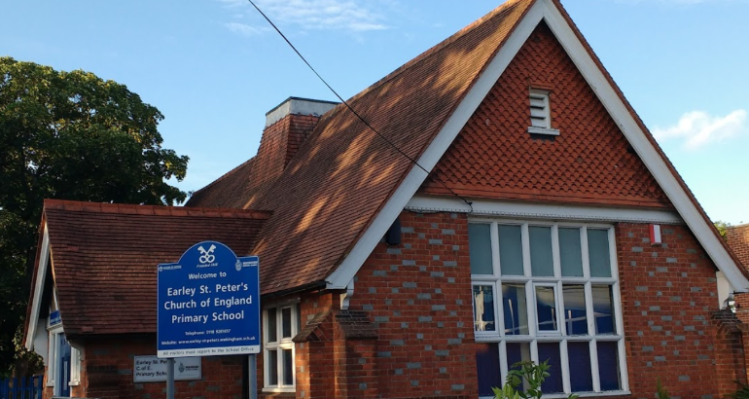
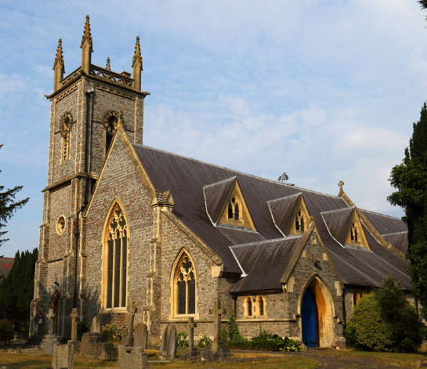
We are part of a large network of high performing schools that support each other, share best practice and resources.
We have a good relationship with local secondary schools and attend open days, sporting events and take part in other extracurricular activities.
Sol Joel park is on our doorstep and we are lucky to
have a partnership with the Earley Town Council
to use the field for sporting events, walks and other
activities such as bug hunts and sponsored events.
We host the Earley Music School each Saturday morning where the community are able to learn a variety of musical instruments.
We work in partnership with a team of professionals from, the Oxford Diocese who support the school both spiritually and educationally.
We enjoy a close relationship with Earley St Peter’s Church. We hold services weekly in the church as well as accessing the church hall for workshops.
Our school is part of the Reading University Schools partnership and we welcome trainee teachers across the year for their school placements as part of their teacher training courses.
We have a strong relationship the Tots and Teddies group which meets termly in the church. Our staff visit the group and get to know parents and children.
Our children are fortunate be taught by Berkshire Maestros. All year 4 children are given the opportunity to learn a brass instrument and perform in a concert at the end of the term.

